Slide 1
Group 14: Fall Finder
Preventing falls in the future
Rossa Fitzsimons
Ross O’dwyer
Dale Chen
Charlotte Weever

Slide 2
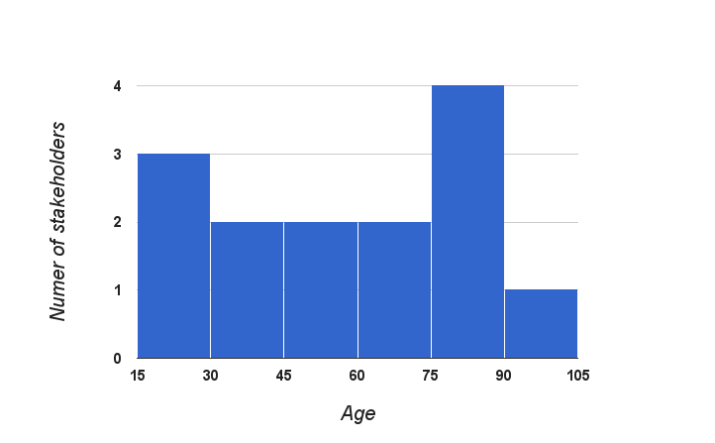
Stakeholders
Elderly and ageing relatives
Students of health sciences (eg. nursing, occupational therapy, speech therapy), some with clinical experience
Notes:
We started by building a network of stakeholders that we could refer to through our concept development process and after that too.

Slide 3
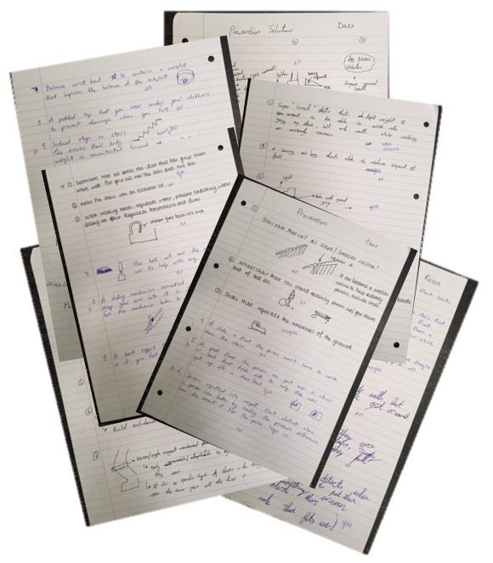
Need-finding research & concept Development
Notes:
We spend some time need-finding, going through different areas of the house to find out what elderly people had the most issue with. 4-3-5 Concept Generation method after to hone in on some idea about prevention. Then we decided on risk of fall detection and data collection. More needs to be done to figure out whether a fall can be preventable or predictable many moons in advance of the fall. This can be done through data collection.

Slide 4
Mission Statement
“ Our aim is to develop a means of minimising the harm caused to individuals by falling through reducing the incidence of falling and/or further enabling fall victims to seek help.”

Slide 5
Concept 1: Smart Walking Stick
Bright LED lights in handle to help the user see their path when walking in the dark and to make users more visible to motorists
Ultrasonic sensors at the foot of the stick measure the distance to the ground and haptic feedback (vibration) is felt at the handle. This could alert the user to upcoming obstacles or uneven surfaces, such as steps, which if unnoticed could cause a fall.

Slide 6
Concept 2: Adjustable Back Pad
The pad is placed behind the user on a chair or bed and extends forward on the push of a button to support the user in getting up.
The blue section will be strong material to hold the weight of the user.
The green should adjust to the shape of the user’s back so that the sit to stand transition is comfortable.
The red shows the adjustable area that alters the angle of the sections.

Slide 7
Concept 3: Fall Risk device (Final concept)
Tiredness: Calibrate threshold distance. Track steps walked per hour.
Accelerometers: Used to detect if a fall/stumble has occurred.

Slide 8
Final Concept Evaluation
Quotes from stakeholders:
“I like the idea, but it still needs some work. It would be a good way of tracking fall history, maybe you could have the patient's medical history in it too?” - Medical Student, TCD
“ I would wear something like this if it would warn me that I was about to fall. I won't wear it if it's ugly though!” - Charlotte’s fashion conscience Nana
The clinicians at MISA also thought it was an interesting idea, but said it needed some work and we need to figure out ways of measuring these values. One mentioned ‘toe clearance’, something that was researched and developed.

Slide 9
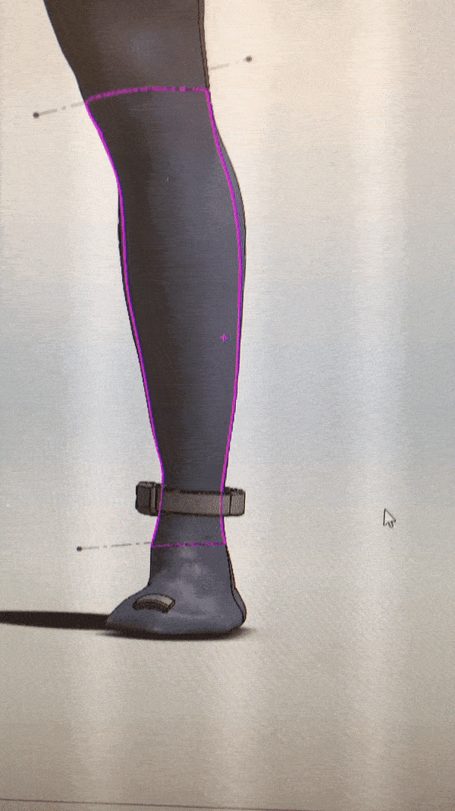
Final Concept: Fall Finder
KEY FEATURES
Toe Clearance: distance between toe and ground. Source of many stumbles. Records all stumbles.
Pedometer to measure steps taken
Accelerometer to measure falls
SD card accessible by users caregiver

Slide 10
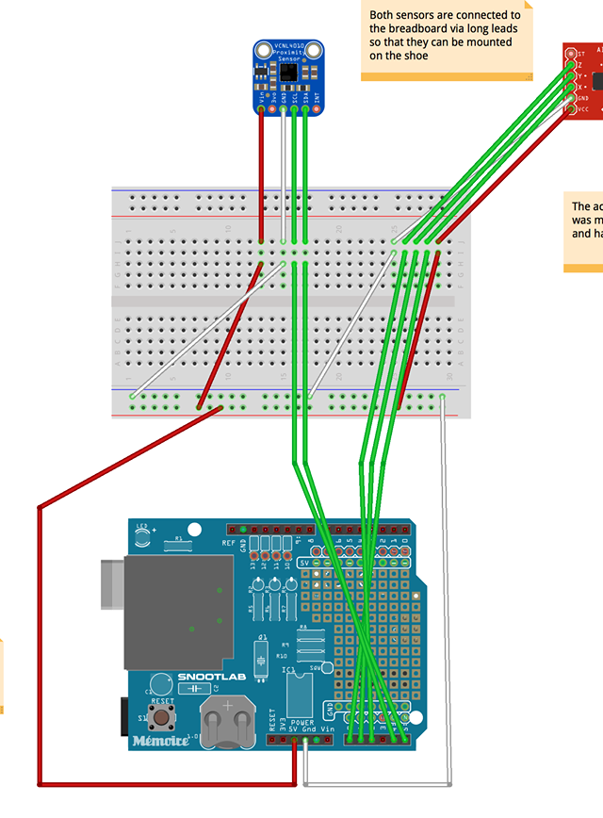
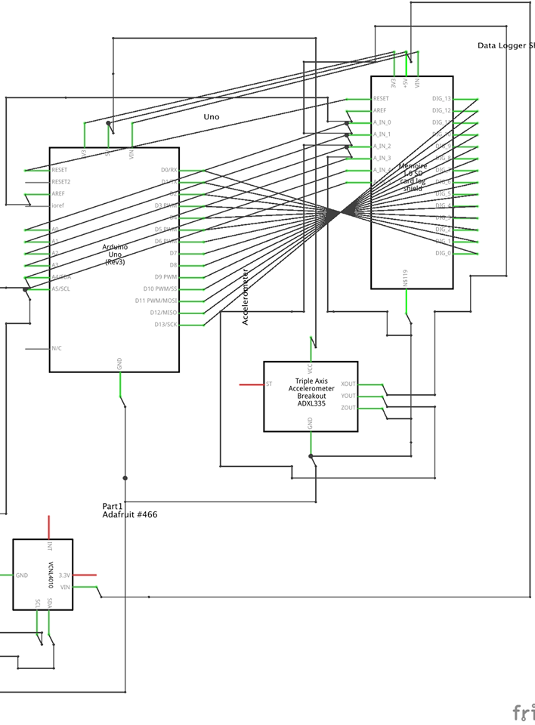
The Engineering bits
Micro-controller (Arduino Uno)
SD card shield
Proximity & Accelerometer sensors
Calibration with Arduino & Matlab

Slide 11
What can be improved?
If the budget was larger, there could be plenty of improvements…
Proximity sensor could be changed from ultrasonic to laser for improved accuracy
Smaller micro-controller to conceal it more easily
Funding for several prototypes to be created and tested by study groups
Improved casing and cloud data collection method rather than SD card

Slide 12
THANK YOU Questions?

